Slide 1
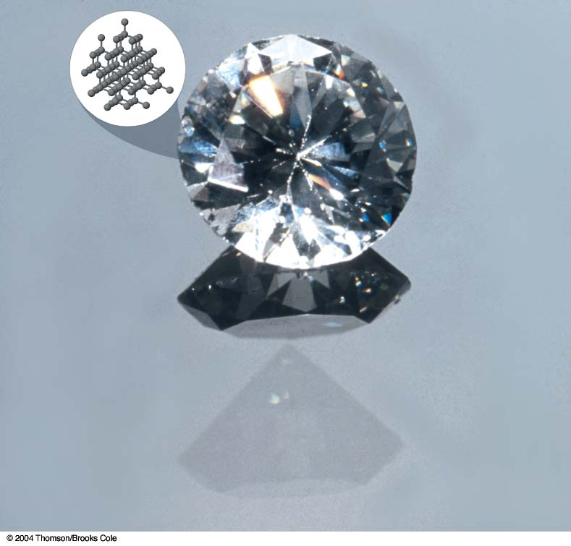
CHAPTER 7
Chemical Bonding

Slide 2
Chapter Goals
Lewis Dot Formulas of Atoms
Ionic Bonding
Formation of Ionic Compounds
Covalent Bonding
Formation of Covalent Bonds
Lewis Formulas for Molecules and Polyatomic Ions
Writing Lewis Formulas: The Octet Rule

Slide 3
Chapter Goals
Resonance
Writing Lewis Formulas: Limitations of the Octet Rule
Polar and Nonpolar Covalent Bonds
Dipole Moments
The Continuous Range of Bonding Types

Slide 4
Introduction
Attractive forces that hold atoms together in compounds are called chemical bonds.
The electrons involved in bonding are usually those in the outermost (valence) shell.

Slide 5
Introduction
Chemical bonds are classified into two types:
Ionic bonding results from electrostatic attractions among ions, which are formed by the transfer of one or more electrons from one atom to another.
Covalent bonding results from sharing one or more electron pairs between two atoms.

Slide 6
Comparison of Ionic and Covalent Compounds
Melting point comparison
  Ionic compounds are usually solids with high melting points
    Typically > 400ºC
  Covalent compounds are gases, liquids, or solids with low melting points
    Typically < 300ºC
Solubility in polar solvents
  Ionic compounds are generally soluble
  Covalent compounds are generally insoluble

Slide 7
Comparison of Ionic and Covalent Compounds
Solubility in nonpolar solvents
  Ionic compounds are generally insoluble
  Covalent compounds are generally soluble
Conductivity in molten solids and liquids
  Ionic compounds generally conduct electricity
    They contain mobile ions
  Covalent compounds generally do not conduct electricity

Slide 8
Comparison of Ionic and Covalent Compounds
Conductivity in aqueous solutions
  Ionic compounds generally conduct electricity
    They contain mobile ions
  Covalent compounds are poor conductors of electricity
Formation of Compounds
  Ionic compounds are formed between elements with large differences in electronegativity
    Often a metal and a nonmetal
  Covalent compounds are formed between elements with similar electronegativities
    Usually two or more nonmetals

Slide 9
Lewis Dot Formulas of Atoms
Lewis dot formulas or Lewis dot representations are a convenient bookkeeping method for tracking valence electrons.
  Valence electrons are those electrons that are transferred or involved in chemical bonding.
    They are chemically important.

Slide 10
Lewis Dot Formulas of Atoms

Slide 11
Lewis Dot Formulas of Atoms
Elements that are in the same periodic group have the same Lewis dot structures.

Slide 12
Ionic Bonding
Formation of Ionic Compounds
An ion is an atom or a group of atoms possessing a net electrical charge.
Ions come in two basic types:
positive (+) ions or cations
    These atoms have lost 1 or more electrons.
negative (-) ions or anions
    These atoms have gained 1 or more electrons.

Slide 13
Formation of
Ionic Compounds
Monatomic ions consist of one atom.
Examples:
  Na⁺, Ca²⁺, Al³⁺ - cations
  Cl⁻, O²⁻, N³⁻ -anions
Polyatomic ions contain more than one atom.
  NH₄⁺ - cation
  NO₂⁻,CO₃²⁻, SO₄²⁻ - anions

Slide 14
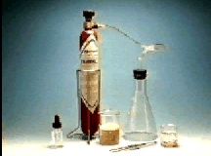

Formation of
Ionic Compounds
Ionic bonds are formed by the attraction of cations for anions usually to form solids.
Commonly, metals react with nonmetals to form ionic compounds.
The formation of NaCl is one example of an ionic compound formation.

Slide 15
Formation of
Ionic Compounds
Reaction of Group IA Metals with Group VIIA Nonmetals

Slide 16
Formation of
Ionic Compounds
Reaction of Group IA Metals with Group VIIA Nonmetals

Slide 17
Formation of
Ionic Compounds
The underlying reason for the formation of LiF lies in the electron configurations of Li and F.
1s 2s 2p
Li ↑↓ ↑
F ↑↓ ↑↓ ↑↓↑↓↑
These atoms form ions with these configurations.
Li⁺ ↑↓ same configuration as [He]
F⁻ ↑↓ ↑↓ ↑↓ ↑↓ ↑↓ same configuration as [Ne]

Slide 18
Formation of
Ionic Compounds
We can also use Lewis dot formulas to represent the neutral atoms and the ions they form.

Slide 19
Formation of
Ionic Compounds
The Li⁺ ion contains two electrons, same as the helium atom.
  Li⁺ ions are isoelectronic with helium.
The F⁻ ion contains ten electrons, same as the neon atom.
  F⁻ ions are isoelectronic with neon.
Isoelectronic species contain the same number of electrons.

Slide 20
Formation of
Ionic Compounds
The reaction of potassium with bromine is a second example of a group IA metal with a Group IIA non metal.
  Write the reaction equation.
You do it!

Slide 21
Formation of
Ionic Compounds
We look at the electronic structures of K and Br.
4s 4p
K [Ar] ↑
Br [Ar] ↑↓ ↑↓ ↑↓ ↑ and the d electrons
The atoms form ions with these electronic structures.
4s 4p
K⁺ same configuration as [Ar]
Br⁻ ↑↓ ↑↓ ↑↓ ↑↓ same configuration as [Kr]

Slide 22
Formation of
Ionic Compounds
Write the Lewis dot formula representation for the reaction of K and Br.
  You do it!

Slide 23
Formation of
Ionic Compounds
There is a general trend evident in the formation of these ions.
Cations become isoelectronic with the preceding noble gas.
Anions become isoelectronic with the following noble gas.

Slide 24
Formation of
Ionic Compounds
In general for the reaction of IA metals and VIIA nonmetals, the reaction equation is:
2 M_{(s)} + X₂ → 2 M⁺ X⁻_{(s)}
  where M is the metals Li to Cs
  and X is the nonmetals F to I.
Electronically this is occurring.
ns np ns np
M ↑→ M⁺
X ↑↓ ↑↓ ↑↓ ↑→ X⁻ ↑↓ ↑↓ ↑↓ ↑↓

Slide 25
Formation of
Ionic Compounds
Next we examine the reaction of IIA metals with VIIA nonmetals.
This reaction forms mostly ionic compounds.
  Notable exceptions are BeCl₂, BeBr₂, and BeI₂ which are covalent compounds.
One example is the reaction of Be and F₂.
Be_{(s)} + F_{2(g)} →BeF_{2(g)}

Slide 26
Formation of
Ionic Compounds
The valence electrons in these two elements are reacting in this fashion.
2s 2p 2s 2p
Be [He] ↑↓  → Be²⁺
F [He] ↑↓ ↑↓ ↑↓ ↑ → F⁻ ↑↓ ↑↓ ↑↓ ↑↓
Next, draw the Lewis dot formula representation of this reaction.
  You do it!

Slide 27
Formation of
Ionic Compounds
The remainder of the IIA metals and VIIA nonmetals react similarly.
Symbolically this can be represented as:
M_{(s)} + X₂ → M²⁺ X₂⁻
  M can be any of the metals Be to Ba.
  X can be any of the nonmetals F to Cl.

Slide 28
Formation of
Ionic Compounds
For the reaction of IA metals with VIA nonmetals, a good example is the reaction of lithium with oxygen.
The reaction equation is:

Slide 29
Formation of
Ionic Compounds
Draw the electronic configurations for Li, O, and their appropriate ions.
  You do it!
2s 2p 2s 2p
Li [He] ↑ → Li¹⁺
O [He] ↑↓ ↑↓ ↑ ↑→ O²⁻ ↑↓ ↑↓ ↑↓ ↑↓
Draw the Lewis dot formula representation of this reaction.
You do it!

Slide 30
Formation of
Ionic Compounds
The remainder of the IA metals and VIA nonmetals behave similarly.
Symbolically this can be represented as:
  2 M _{(s)} + X → M₂¹⁺ X⁻
  M can be any of the metals Li to Cs.
  X can be any of the nonmetals O to Te.

Slide 31
Formation of
Ionic Compounds
The reaction of IIA metals and VA nonmetals also follows the trends that we have established in this chapter.
The reaction of calcium with nitrogen is a good example.
The reaction equation is:
  You do it!

Slide 32
Formation of
Ionic Compounds
Draw the electronic representation of Ca, N, and their ions.
  You do it!
4s 4p 4s 4p
Ca [Ar] ↑↓→ Ca²⁺
2s 2p 2s 2p
N [He] ↑↓ ↑ ↑ ↑→ N³⁻ ↑↓ ↑↓ ↑↓ ↑↓
Draw the Lewis dot representation of this reaction.
  You do it!

Slide 33
Formation of
Ionic Compounds
Other IIA and VA elements behave similarly.
Symbolically, this reaction can be represented as:
  3 M_{(s)} + 2 X_{(g)} → M₃²⁺ X₂³⁻
M can be the IIA elements Be to Ba.
X can be the VA elements N to As.

Slide 34
Formation of
Ionic Compounds
Simple Binary Ionic Compounds Table
Reacting Groups Compound General Formula Example
  IA + VIIA MX NaF
  IIA + VIIA MX₂ BaCl₂
  IIIA + VIIA MX₃ AlF₃
  IA + VIA M₂X Na₂O
  IIA + VIA MX BaO
  IIIA + VIA M₂X₃ Al₂S₃

Slide 35
Formation of
Ionic Compounds
Reacting Groups Compound General Formula Example
  IA + VA M₃X Na₃N
  IIA + VA M₃X₂ Mg₃P₂
  IIIA + VA MX AlN
  H, a nonmetal, forms ionic compounds with IA and IIA metals for example, LiH, KH, CaH₂, and BaH₂.
    Other hydrogen compounds are covalent.

Slide 36
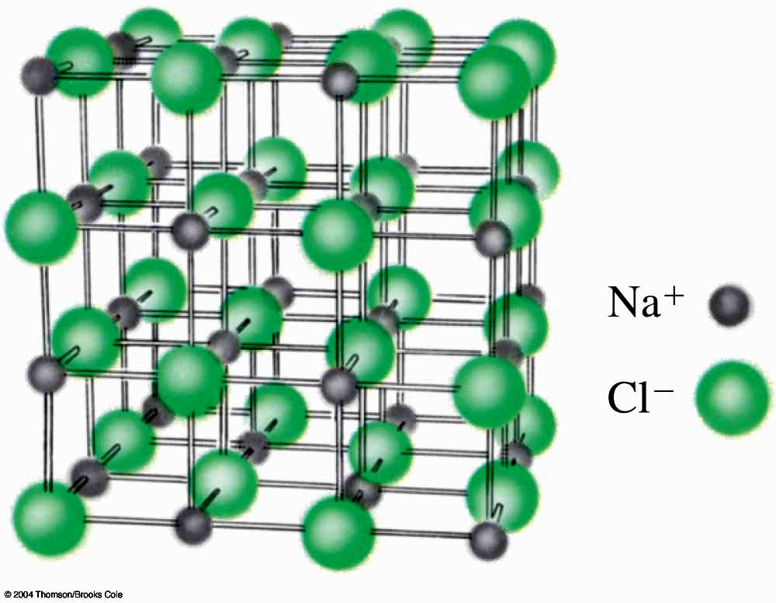
Formation of
Ionic Compounds
Ionic compounds form extended three dimensional arrays of oppositely charged ions.
Ionic compounds have high melting points because the coulomb force, which holds ionic compounds together, is strong.

Slide 37
Formation of
Ionic Compounds
Coulomb’s Law describes the attraction of positive ions for negative ions due to the opposite charges.

Slide 38
Formation of
Ionic Compounds
Small ions with high ionic charges have large Coulombic forces of attraction.
Large ions with small ionic charges have small Coulombic forces of attraction.
Use this information, plus the periodicity rules from Chapter 6, to arrange these compounds in order of increasing attractions among ions
  KCl, Al₂O₃, CaO
  You do it!

Slide 39
Covalent Bonding
Covalent bonds are formed when atoms share electrons.
If the atoms share 2 electrons a single covalent bond is formed.
If the atoms share 4 electrons a double covalent bond is formed.
If the atoms share 6 electrons a triple covalent bond is formed.
  The attraction between the electrons is electrostatic in nature
    The atoms have a lower potential energy when bound.

Slide 40
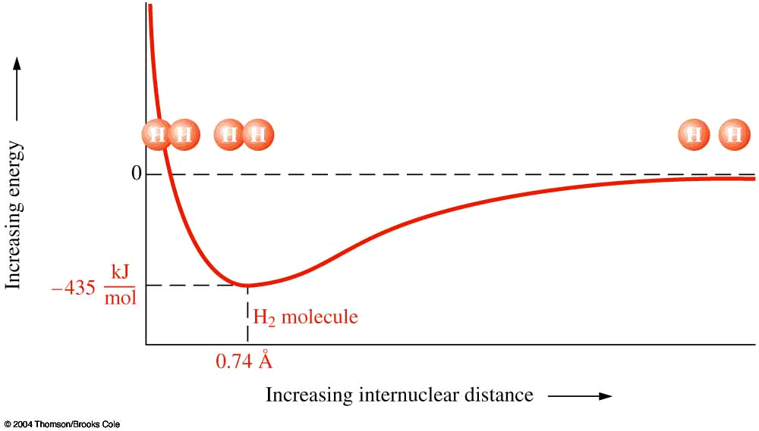
Formation of
Covalent Bonds
This figure shows the potential energy of an H₂ molecule as a function of the distance between the two H atoms.

Slide 41
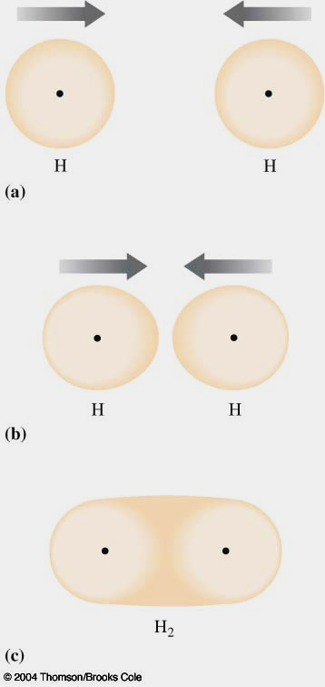
Formation of
Covalent Bonds
Representation of the formation of an H₂ molecule from H atoms.

Slide 42
Formation of
Covalent Bonds
We can use Lewis dot formulas to show covalent bond formation.
H molecule formation representation.
HCl molecule formation

Slide 43
Lewis Formulas for Molecules and Polyatomic Ions
First, we explore Lewis dot formulas of homonuclear diatomic molecules.
  Two atoms of the same element.
Hydrogen molecule, H₂.
Fluorine, F₂.
Nitrogen, N₂.

Slide 44
Lewis Formulas for Molecules and Polyatomic Ions
Next, look at heteronuclear diatomic molecules.
  Two atoms of different elements.
    Hydrogen halides are good examples.
hydrogen fluoride, HF
hydrogen chloride, HCl
hydrogen bromide, HBr

Slide 45
Lewis Formulas for Molecules and Polyatomic Ions
Now we will look at a series of slightly more complicated heteronuclear molecules.
Water, H₂O

Slide 46
Lewis Formulas for Molecules and Polyatomic Ions
Ammonia molecule , NH₃

Slide 47
Lewis Formulas for Molecules and Polyatomic Ions
Lewis formulas can also be drawn for molecular ions.
One example is the ammonium ion , NH₄⁺.
Notice that the atoms other than H in these molecules have eight electrons around them.

Slide 48
Writing Lewis Formulas:
The Octet Rule
The octet rule states that representative elements usually attain stable noble gas electron configurations in most of their compounds.
Lewis dot formulas are based on the octet rule.
We need to distinguish between bonding (or shared) electrons and nonbonding (or unshared or lone pairs) of electrons.

Slide 49
Writing Lewis Formulas:
The Octet Rule
N - A = S rule
  Simple mathematical relationship to help us write Lewis dot formulas.
N = number of electrons needed to achieve a noble gas configuration.
  N usually has a value of 8 for representative elements.
  N has a value of 2 for H atoms.
A = number of electrons available in valence shells of the atoms.
  A is equal to the periodic group number for each element.
  A is equal to 8 for the noble gases.
S = number of electrons shared in bonds.
A-S = number of electrons in unshared, lone, pairs.

Slide 50
Writing Lewis Formulas:
The Octet Rule
For ions we must adjust the number of electrons available, A.
  Add one e⁻ to A for each negative charge.
  Subtract one e⁻ from A for each positive charge.
The central atom in a molecule or polyatomic ion is determined by:
  The atom that requires the largest number of electrons to complete its octet goes in the center.
  For two atoms in the same periodic group, the less electronegative element goes in the center.

Slide 51
Writing Lewis Formulas:
The Octet Rule
Example 7-2: Write Lewis dot and dash formulas for hydrogen cyanide, HCN.
N = 2 (H) + 8 (C) + 8 (N) = 18
A = 1 (H) + 4 (C) + 5 (N) = 10
S = 8
A-S = 2
This molecule has 8 electrons in shared pairs and 2 electrons in lone pairs.

Slide 52
Writing Lewis Formulas:
The Octet Rule
Example 7-3: Write Lewis dot and dash formulas for the sulfite ion, SO₃²⁻.
N = 8 (S) + 3 x 8 (O) = 32
A = 6 (S) + 3 x 6 (O) + 2 (- charge) = 26
S = 6
A-S = 20
Thus this polyatomic ion has 6 electrons in shared pairs and 20 electrons in lone pairs.
Which atom is the central atom in this ion?
You do it!

Slide 53
Writing Lewis Formulas:
The Octet Rule
What kind of covalent bonds, single, double, or triple, must this ion have so that the six shared electrons are used to attach the three O atoms to the S atom?

Slide 54
Resonance
Example 7-4: Write Lewis dot and dash formulas for sulfur trioxide, SO₃.
  You do it!
N = 8 (S) + 3 x 8 (O) = 32
A = 6 (S) + 3 x 6 (O) = 24
S = 8
A-S = 16

Slide 55
Resonance
There are three possible structures for SO₃.
  The double bond can be placed in one of three places.
When two or more Lewis formulas are necessary to show the bonding in a molecule, we must use equivalent resonance structures to show the molecule’s structure.
  Double-headed arrows are used to indicate resonance formulas.

Slide 56
Resonance
Resonance is a flawed method of representing molecules.
  There are no single or double bonds in SO₃.
    In fact, all of the bonds in SO₃ are equivalent.
The best Lewis formula of SO₃ that can be drawn is:

Slide 57
Writing Lewis Formulas:
Limitations of the Octet Rule
There are some molecules that violate the octet rule.
  For these molecules the N - A = S rule does not apply:
The covalent compounds of Be.
The covalent compounds of the IIIA Group.
Species which contain an odd number of electrons.
Species in which the central element must have a share of more than 8 valence electrons to accommodate all of the substituents.
Compounds of the d- and f-transition metals.

Slide 58
Writing Lewis Formulas:
Limitations of the Octet Rule
In those cases where the octet rule does not apply, the substituents attached to the central atom nearly always attain noble gas configurations.
The central atom does not have a noble gas configuration but may have fewer than 8 (exceptions 1, 2, & 3) or more than 8 (exceptions 4 & 5).

Slide 59
Writing Lewis Formulas:
Limitations of the Octet Rule
Example 7-5: Write dot and dash formulas for BBr₃.
  This is an example of exception #2.
You do it!

Slide 60
Writing Lewis Formulas:
Limitations of the Octet Rule
Example 7-6: Write dot and dash formulas for AsF₅.
You do it!

Slide 61
Polar and Nonpolar Covalent Bonds
Covalent bonds in which the electrons are shared equally are designated as nonpolar covalent bonds.
  Nonpolar covalent bonds have a symmetrical charge distribution.
To be nonpolar the two atoms involved in the bond must be the same element to share equally.

Slide 62
Polar and Nonpolar Covalent Bonds
Some examples of nonpolar covalent bonds.
H₂
N₂

Slide 63
Polar and Nonpolar Covalent Bonds
Covalent bonds in which the electrons are not shared equally are designated as polar covalent bonds
  Polar covalent bonds have an asymmetrical charge distribution
To be a polar covalent bond the two atoms involved in the bond must have different electronegativities.

Slide 64
Polar and Nonpolar Covalent Bonds
Some examples of polar covalent bonds.
HF

Slide 65
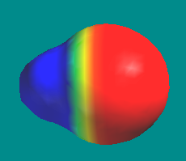
Polar and Nonpolar Covalent Bonds
Shown below is an electron density map of HF.
  Blue areas indicate low electron density.
  Red areas indicate high electron density.
Polar molecules have a separation of centers of negative and positive charge, an asymmetric charge distribution.

Slide 66
Polar and Nonpolar Covalent Bonds
Compare HF to HI.

Slide 67
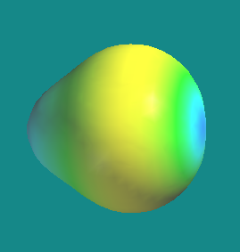
Polar and Nonpolar Covalent Bonds
Shown below is an electron density map of HI.
  Notice that the charge separation is not as big as for HF.
    HI is only slightly polar.

Slide 68
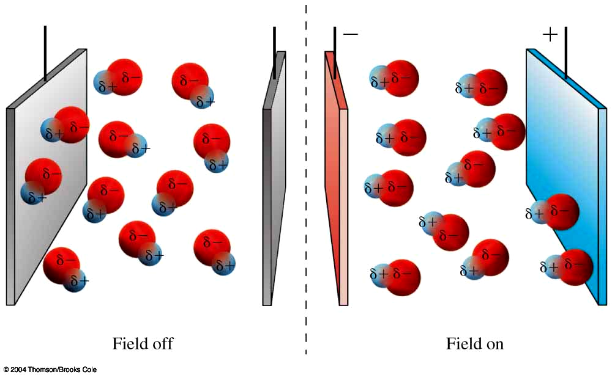
Polar and Nonpolar Covalent Bonds
Polar molecules can be attracted by magnetic and electric fields.

Slide 69
Dipole Moments
Molecules whose centers of positive and negative charge do not coincide, have an asymmetric charge distribution, and are polar.
  These molecules have a dipole moment.
The dipole moment has the symbol μ.
μ is the product of the distance,d, separating charges of equal magnitude and opposite sign, and the magnitude of the charge, q.

Slide 70
Dipole Moments
Molecules that have a small separation of charge have a small μ.
Molecules that have a large separation of charge have a large μ.
For example, HF and HI:

Slide 71
Dipole Moments
There are some nonpolar molecules that have polar bonds.
There are two conditions that must be true for a molecule to be polar.
There must be at least one polar bond present or one lone pair of electrons.
The polar bonds, if there are more than one, and lone pairs must be arranged so that their dipole moments do not cancel one another.

Slide 72
The Continuous Range of Bonding Types
Covalent and ionic bonding represent two extremes.
In pure covalent bonds electrons are equally shared by the atoms.
In pure ionic bonds electrons are completely lost or gained by one of the atoms.
Most compounds fall somewhere between these two extremes.

Slide 73
Continuous Range of
Bonding Types
All bonds have some ionic and some covalent character.
  For example, HI is about 17% ionic
The greater the electronegativity differences the more polar the bond.

Slide 74
Synthesis Question
As we all know, in the wintertime we are more likely to get shocked when we walk across carpet and touch the door knob. Here is another wintertime experiment to perform. Turn on a water faucet until you have a continuous but small stream of water coming from the faucet. Brush your hair vigorously then hold the brush near the stream of water.

Slide 75
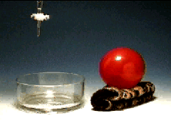
Synthesis Question
You will notice that the stream bends towards the brush. Why does the water bend?

Slide 76
Synthesis Question
Since water is a highly polar molecule, it is attracted by the electromagnetic field generated by the hair brush. This causes the stream to bend.

Slide 77
Group Question
On a recent “infomercial” it was claimed that placing a small horseshoe magnet over the fuel intake line to your car’s carburetor would increase fuel mileage by 50%. The reason given for the mileage increase was that “the magnet aligned the molecules causing them to burn more efficiently.” Will this work? Should you buy this product?

Slide 78
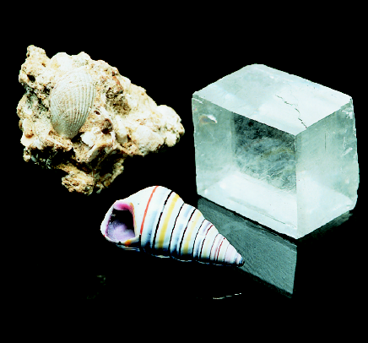
End of Chapter 7

